Slide 1

Java Basics I
EE422C - Software Design and Implementation II (Thanks to Edison Thomaz)

Slide 2
Java Basics
History and Language Characteristics
Hello World
Program Structure
Java API and Hierarchy
Compilation and VM
Primitive Data Types
Control Statements
Variable Storage Models
Garbage Collection

Slide 3
Week 1 – Recitation
Installing Java 8
Getting started with Java development setup
Code and run a simple HelloWorld program
Open Github account
Questions of what we covered in class

Slide 4

Development started in June 1991
Sun Microsystems (acquired by Oracle in 2009)
Designed for interactive television
Released in 1995/1996
5 primary goals for creating a new language
simple, object-oriented, and familiar
robust and secure
architecture neutral and portable
high-performance
interpreted, threaded and dynamic

Slide 5
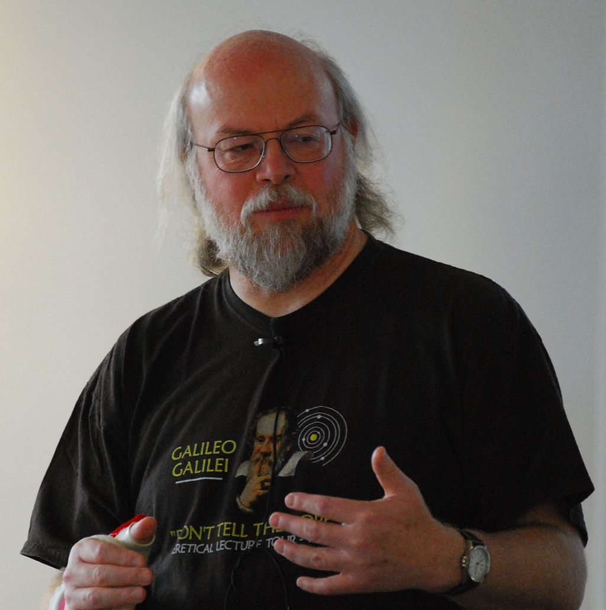
James Gosling
Inventor of Java programming language

Slide 6
HelloWorld.java
filename must match public class name
public class HelloWorld
{
public static void main(String[] args)
{
// Display a greeting in the console window
System.out.println("Hello, World!");
}
}
Program Run:
Hello, World!

Slide 7
The Structure of a Simple Program
Classes are the fundamental building blocks of Java programs:
public class HelloWorld
starts a new class and defines a blue-print for HelloWorld
Every source file can contain at most one public class
The name of the public class must match the name of the file containing that class:
Source code for class HelloWorld must be contained in a file named HelloWorld.java
Every Java application contains a class with a main method
When the application starts, the instructions in the main method are executed
public static void main(String[] args)
{
. . .
}
declares a main method which can take an array of Strings as an argument (usually file names for late binding)

Slide 8
The Structure of a Simple Program: Statements
Syntax is just like C: free format, tokens and delimeters same
The body of the class and of the main method contains statements inside the curly brackets ({})
Each statement ends in a semicolon (;)
Statements are executed one by one
Our example program has a single executable statement:
System.out.println("Hello, World!");
which prints a line of text on the standard output device (console):
Hello, World!

Slide 9

The Guts of a Simple Program: e.g. Method Calls
System.out.println("Hello, World!");
is a method call of the form
object.methodName(parameter-arguments);
An instance method (not static) call requires:
The object that you want to use (in this case, System.out) – specifically the out object found in the System class (which is defined to be the standard output device, i.e. the console/screen)
The name of the method you want to use (in this case, println) – a method which prints out a string of text followed by a new line character
Parameter arguments enclosed in parentheses (()) containing any other information the method requires (in this case the String, "Hello, World!")
Arguments

Slide 10
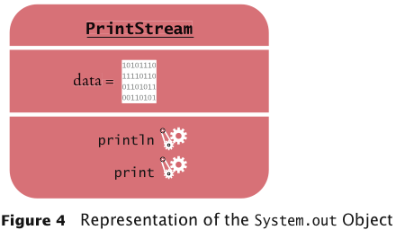
Objects - Example
Object: an instance of a class and can contain data elements and methods (e.g., System.out belongs to the class PrintStream)
System.out
printf

Slide 11
Methods
Method: sequence of instructions that accesses the data elements of an object
You manipulate objects by calling its related methods
Class (as the blue print of an object), determines the legal methods for that object:
String greeting = "Hello, World!";
greeting.println() // Error,no println method in String
System.out.println(greeting); // OK
greeting.length() // OK
2 different kinds of methods: static and instance
static methods work just like C functions – called by name
Instance methods require an object reference, e.g. above

Slide 12
Methods
Static or class methods
Called as in -> [Classname.]method(arguments);
All method arguments are passed to their formal parameters by call-by-value
Primitive types: value is passed to the method
Method may modify local copy but will not affect caller’s value
Object reference: address of object is passed
Change to reference variable does not affect caller
But operations can affect the object’s state, visible to caller

Slide 13
Simple static methods - summary
public class MinTest
{
public static void main( String [ ] args )
{
int a = 3;
int b = 7;
System.out.println( min( a, b ) );
}
// method definition
public static int min( int x, int y )
{
return x < y ? x : y;
}
}

Slide 14
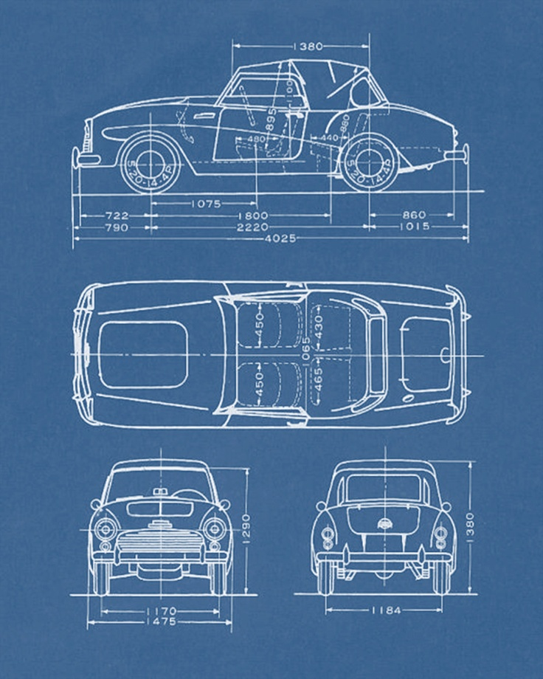
Another analogy… a class
public class Car
wheels
engine
headlights
tires
accelerate()
brake()
turnOnLights()
turnOffLights()

Slide 15
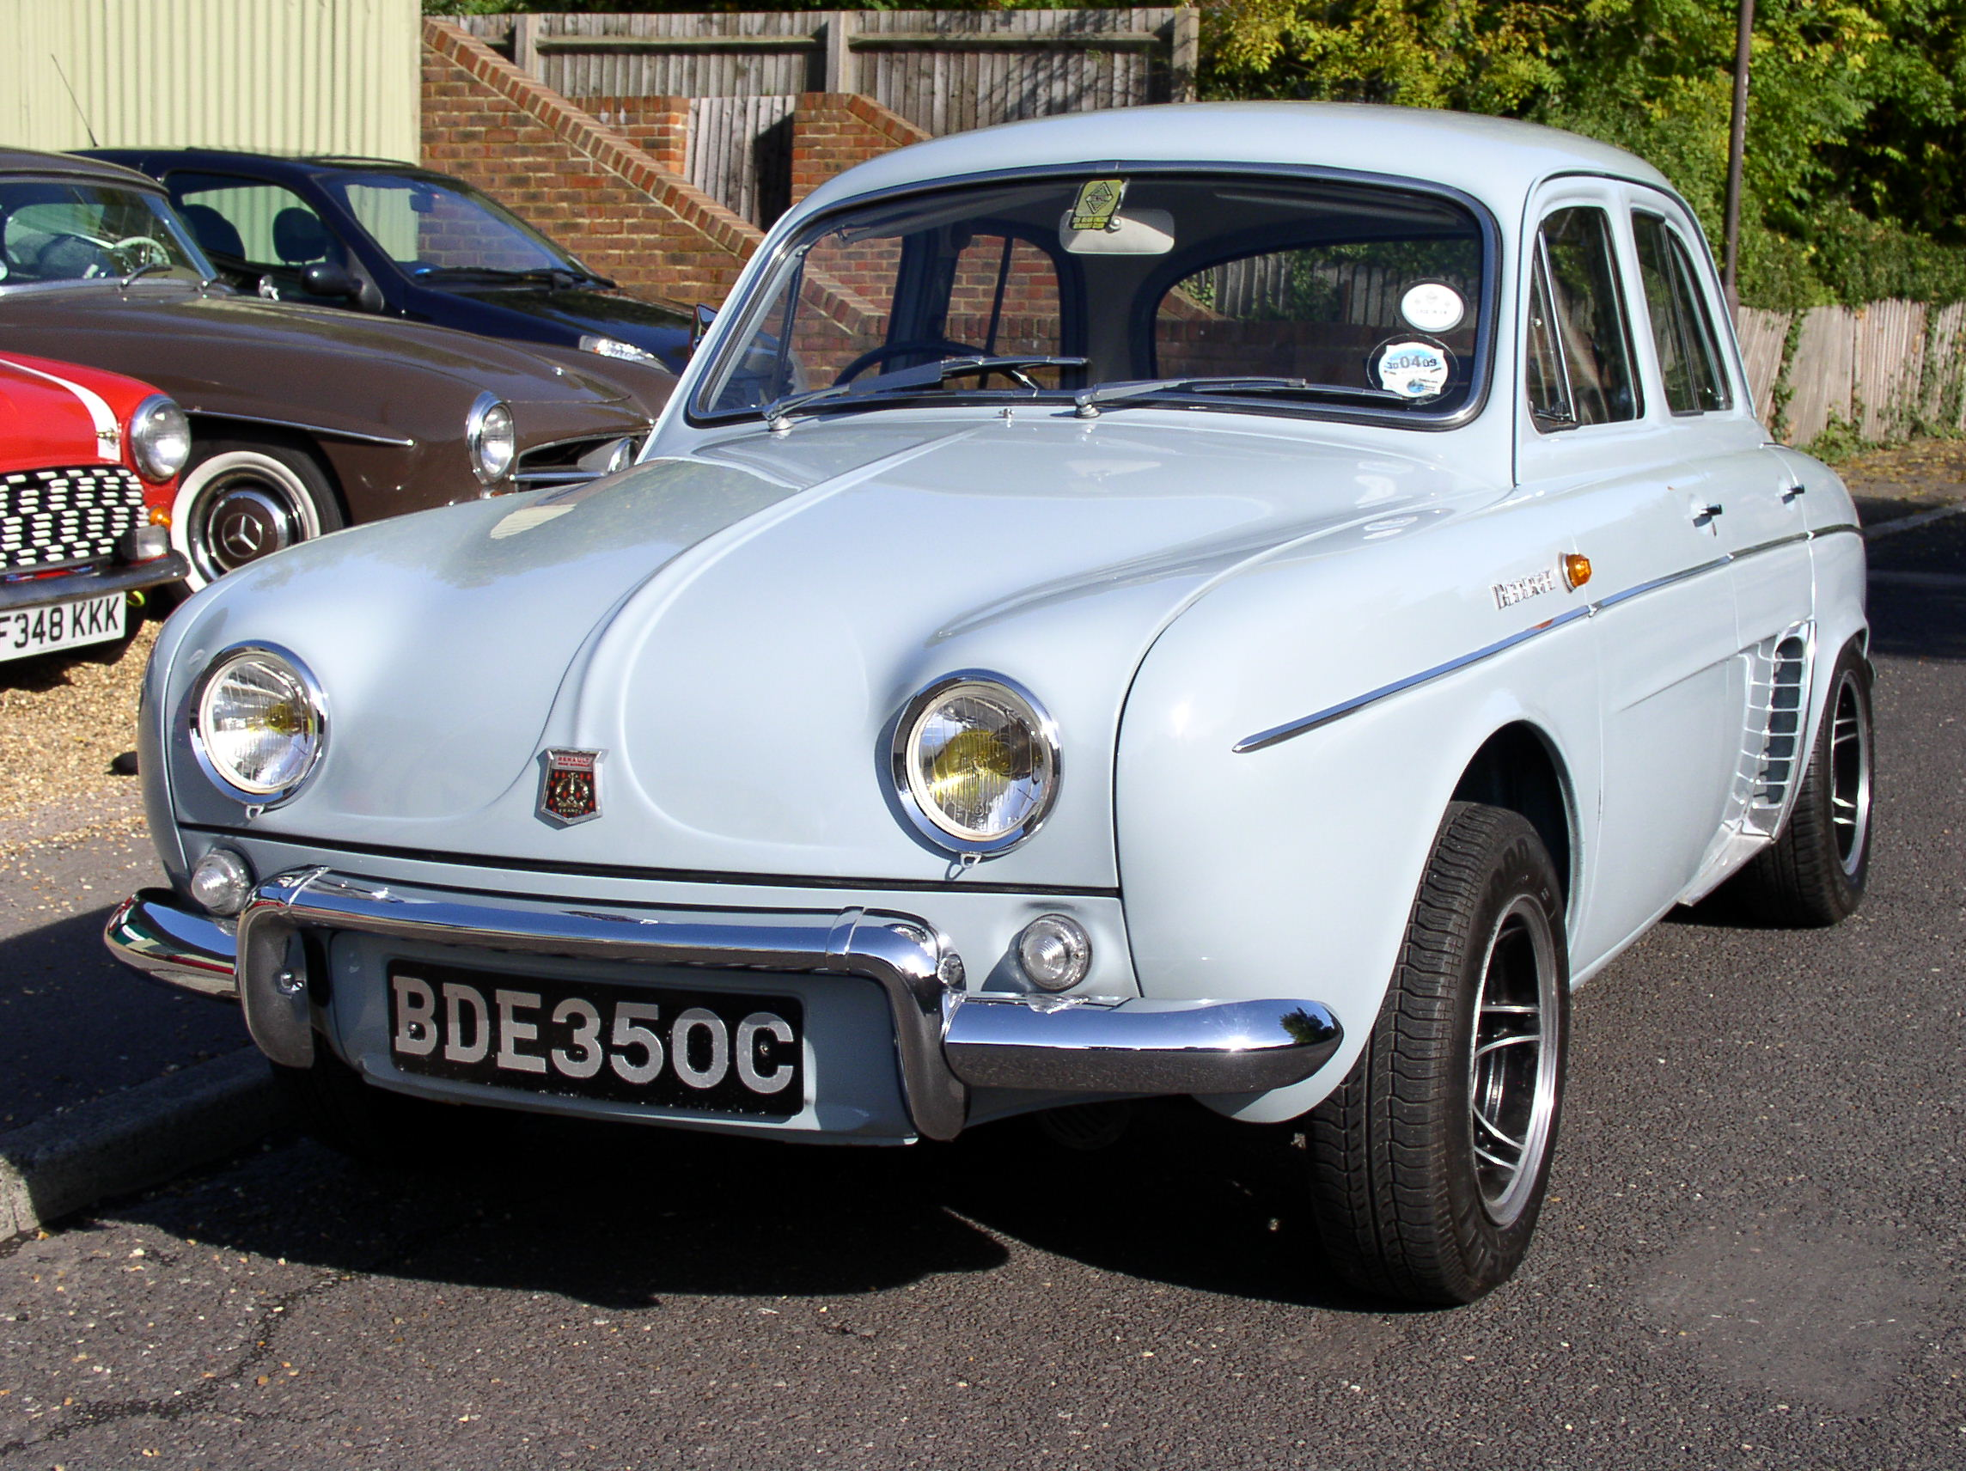
Another analogy… an object
myCar = new Car();
myCar.turnOnLights()
myCar.accelerate()

Slide 16
Java Organizing Concept
Java API
Libraries
Packages
Classes
Methods
Statements
Tokens
Made of symbols from Java alphabet

Slide 17
Grouping Classes: The Java API
API = Application Programming Interface
A package consists of some related Java classes:
Swing: a GUI (graphical user interface) package
AWT: Abstract Window Toolkit (more GUI)
util: utility data structures (important to us)
The import statement tells the compiler to make available classes and methods of another package
A main method indicates where to begin executing a class (if it is designed to be run as an application program)

Slide 18
Accessibility Specifications
access specifiers (public, private, and protected) are placed on each definition for each member of a class (rather then on a block of members as in C++) as well as the class itself
The class, and each variable or method within the class (that is not inside a method), has an access specifier to determine whether it’s visible outside the file or class that it is in
Without an explicit access specifier, a class member defaults to "friendly," which means that it is accessible to other elements in the same package (a package is a collection of classes being ‘friends‘)
Inside of methods - variables, etc. are treated as usual (local)

Slide 19
Portability
Java is (an interpreted) write once, run anywhere language.
Uses a virtual machine (VM) concept
Write once, run everywhere (nearly) NEVER works with C/C++, but does (nearly) ALWAYS work with JAVA.
The biggest potential stumbling block is speed:
Interpreted Java runs in the range of 20 times slower than C.
But: nothing prevents the Java language from being compiled and there are just-in-time (JIT) compilers that offer significant speed-ups.

Slide 20



Running a program
Write it.
code or source code: The set of instructions in a program.
Compile it.
compile: Translate a program from one language to another.
byte code: The Java compiler converts your code into a format named byte code that runs on many computer types.
Run (execute) it.
output: The messages printed to the user by a program.
source code
byte code
output
compile
run

Slide 21
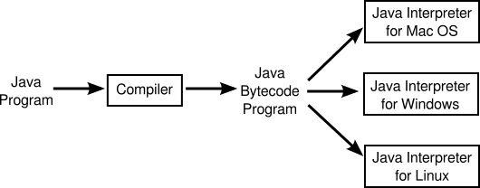
Running a program

Slide 22
Primitive Java is just like C (within methods)
Syntax – free form, case sensitive, punctuation same
Comments
Primitive data types – same except char
Constants
Declaration and initialization statements
Basic operators
Relational, equality, logical operators
Type conversions
Conditional statements
Iteration statements
Break and continue statements
Conditional operator ?
Static methods (=> C functions)

Slide 23
java: differences from C/C++
no typedefs, no #defines, No preprocessor
no structures, unions
no functions (~= static methods)
no multiple inheritance
no goto ☺
http://www.cs.utexas.edu/~EWD/ewd02xx/EWD215.PDF
no operator overloading
no pointer data type, no pointer arithmetic

Slide 24
Reserved Words in JAVA(58)
abstract
boolean
break
byte
case
cast
catch
char
class
const
continue
default
do
double
else
extends
false
final
finally
float
for
future
generic
if
implements
import
inner
instanceof
int
interface
long
native
new
null
operator
outer
package
private
protected
public
rest
return
short
static
super
switch
synchronized
this
throw
throws
transient
true
try
var
void
volatile
while

Slide 25
Identifiers
Identifier: name of a variable, method, or class
Rules for identifiers in Java:
Can be made up of letters, digits, underscores (_) and dollar signs ($)
Cannot start with a digit
Cannot use other symbols such as ? or %
Spaces are not permitted inside identifiers
You cannot use reserved words such as public
They are case sensitive
By convention, variable names start with a lowercase letter
“Camel case”: Capitalize the first letter of a subsequent word in a compound name such as farewellMessage
By convention, class names start with an uppercase letter
Should not use the $ symbol at the beginning of your names — intended for names that are automatically generated by tools
Identifier names must be meaningful and explainable to someone else
These are very strong conventions!

Slide 26
Identifiers
legal: _myName TheCure ANSWER_IS_42 bling$
illegal: me+u 49ers side-swipe Ph.D's double
my Name

Slide 27
Comments are almost like C
/* This kind of comment can span multiple lines
of text – as many as you need
*/
// This kind is to the end of the line only
/** * This kind of comment is a special * ‘javadoc’ style comment which we will
* use for API style auto documentation
*/

Slide 28
Data Types
All values have a type
Primitive types
Represent numbers, characters, boolean values
Integers: byte, short, int, and long
Real numbers: float and double
Characters: char
Truth values: boolean (true or false)
Non primitive types are objects, aka
Reference types (not really pointers – no arithmetic), class instances

Slide 29
java: type safety
strongly typed language
there cannot be any type errors when the program runs
automatic storage management
no dangling pointers
array index bounds checking

Slide 30
Primitive Data Types
Type | Description | Size
int | The integer type, with range -2,147,483,648 . . . 2,147,483,647 | 4 bytes
byte | The type describing a single byte, with range -128 . . . 127 | 1 byte
short | The short integer type, with range -32768 . . . 32767 | 2 bytes
long | The long integer type, with range -9,223,372,036,854,775,808 . . . 9,223,372,036,854,775,807 | 8 bytes
double | The double-precision floating-point type, with a range of about ±10³⁰⁸ and about 15 significant decimal digits | 8 bytes
float | The single-precision floating-point type, with a range of about ±10³⁸ and about 7 significant decimal digits | 4 bytes
char | The character type, representing code units in the Unicode encoding scheme | 2 bytes
boolean | The type with the two truth values false and true | 1 bit

Slide 31
Operators/Precedence
subscript [ ], method call ( ), member access .
pre/post-increment ++ --, boolean complement !, bitwise complement ~, unary + -, type cast (type), object creation new
* / %
binary + - (+ also concatenates strings)
signed shift << >>, unsigned shift >>>
comparison < <= > >=, class test instanceof
equality comparison == !=
bitwise and &
bitwise or |
logical (sequential) and &&
logical (sequential) or ||
conditional cond ? true-expr : false-expr
assignment =, compound assignment += -= *= /= <<= >>= >>>= &= |=
Use ( ) to force a specific order of expression evaluation

Slide 32
Type Compatibility and Conversions
Compatible types converted automatically – e.g. int to long
Incompatible would be like double to byte, or char to boolean
Incompatible types must use cast
Widening conversion:
In operations on mixed-type operands, the numeric type of the smaller range is converted to the numeric type of the larger range
In an assignment, a numeric type of smaller range can be assigned to a numeric type of larger range without loss of information
byte to short to int to long
int kind to float to double
Narrowing conversion
Must case, result with be modulo smaller type range

Slide 33
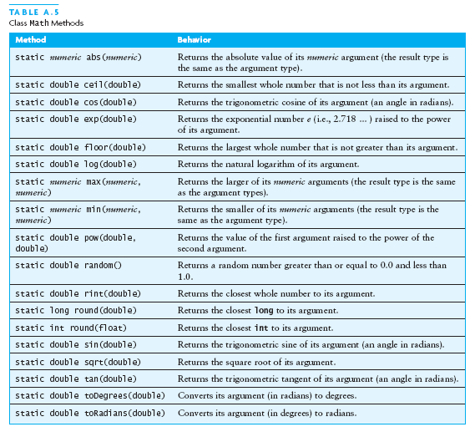
The Class Math

Slide 34
Math Methods Use
Called using the form Math.methodname (x , y);
A math method call becomes a value as a result. These can be used in any arithmetic expression.
These methods are in the standard Java.lang library that gets included automatically with all programs.
You don’t need to import it.
// for example,
double x, y;
y = 179.66;
x = Math.sqrt (y) + 15.33;

Slide 35
The Char Data Type
char firstLetter = ‘A’; //example char variable declaration
Used for readable text and keyboard symbols
A character is stored in 16 bit Unicode representation, the rightmost 8 bits is ASCII for English language symbols
e.g. the letter ‘A’ is
00000000 01000001 (in binary)
which is 65 in decimal
see Unicode web site for the definition of all represented character symbols
http://www.unicode.org/
chars can be compared using relational operators
For Example:( assume the usual program plumbing exists)
char letter1 = ‘b’, letter2 = ‘Z’;
if (letter1 < letter2) System.out.println (“1st letter smaller”);

Slide 36
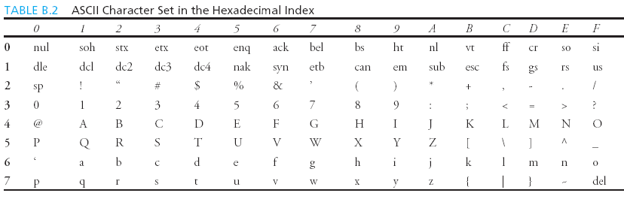
ASCII Character Subset
ASCII Character Set is a subset of the Unicode from \u0000 to \u007f
\u means unicode
First
digit
Second digit

Slide 37
Unicode Format - escapes
Description Escape Sequence Unicode(hex)
Backspace \b \u0008
Tab \t \u0009
Linefeed \n \u000a
Carriage return \r \u000d

Slide 38
Casting between char and Numeric Types
Automatic conversions done as in C
int i = 'a'; // Same as int i = (int)'a';
char c = 97; // Same as char c = (char)97;

Slide 39
Control statements are like C
if (x < y) smaller = x;
if (x < y){ smaller=x; sum = sum + x;}
else { smaller = y; sum = sum + y; }
while (x < y) { y = y - x; }
do { y = y - x; } while (x < y)
for (int i = 0; i < max; i++) sum =sum + i;
BUT: the conditions must be boolean !
break;
continue;
work like C

Slide 40
Control statements/2
Conditional operator ? – short hand for simple if-else
int x, y, minVal; // . . .
minVal = x<=y ? x : y;
Switch statement
switch( someCharacter )
{ case '(':
case '[’:
case '{':
// Code to process opening symbols
break;
case ')':
case ']':
case '}':
// Code to process closing symbols
break;
case '\n':
// Code to handle newline character
break;
default:
// Code to handle other cases
}
Could also be
an integer expression

Slide 41
Variable Storage Modes
variables that are declared inside the body of a method are local (automatic storage)
created when the method body is executed and disappear when the method body terminates.
A variable declared outside the body of a method is global to the whole class.
Its scope outside the class is determined by its access specifier (public, private, protected, blank)
A static variable is allocated once, and remembers
static final variables are used as symbolic constants. E.g.
static final double PI = 3.1416;
symbolic constants are defined in uppercase.
If several words are needed they are separated by the underscore character, e.g. MAX_INT_VALUE.

Slide 42
The static modifier
A static variable is a class level variable, not an instance variable; in effect shared by all objects if not inside a method
A static method is a class level method, not an instance method
Encapsulates some computation task
Cannot refer to this or super
A static block in a class can be declared to initialize static variables; it is run once when the class is loaded
static { // static variable inits here }

Slide 43
The final Modifier
The final class cannot be extended (no subclasses):
final class Math
{...}
The final variable is a constant:
final static double PI = 3.1416;
The final method cannot be modified by any subclasses.

Slide 44
Garbage Collection
When a constructed object is no longer referenced by any object variable, the memory it consumes will automatically be reclaimed.
No “delete” or destructors.
The JVM runtime system guarantees that as long as it is possible to access an object by a reference, or a chain of references, the object will never be reclaimed.
Once the object is unreachable by a chain of references, it can be reclaimed at the discretion of the runtime system if memory is low.
It is possible that if memory does not run low, the virtual machine will not attempt to reclaim these objects.

Slide 45
Garbage Collection
Garbage collection means memory leaks are much harder to cause in Java, but not impossible.
If you make native (non Java) method calls that allocate storage, these are typically not tracked by the garbage collector.
The garbage collector is a huge improvement over C++, and makes a lot of programming problems simply vanish.
It might make Java unsuitable for solving a small subset of problems that cannot tolerate a garbage collector, but the advantage of a garbage collector seems to greatly outweigh this potential drawback.

Slide 46
Questions

